Slide 1
The need for additional screening for women with dense breasts in Nova Scotia
Paula B Gordon, OC, OBC, MD, FRCPC, FSBI
Clinical Professor, University of British Columbia
Volunteer Advisor: Dense breasts Canada
February 23, 2024
Notes:
Good morning.
I’m Dr Paula Gordon. It’s a pleasure to speak with you today. I’m a breast radiologist and have practiced in Vancouver for 40 years. I also volunteer as the medical advisor for Dense Breasts Canada (I’ll call it DBC for short). DBC has been advocating for years in Nova Scotia, first that all women be told their density category and then for additional screening for women w dense breasts.
Nova Scotia is the only province where women with dense breasts are denied essential supplementary screening, even if it is ordered by their GP or NP. Today, I’m going to quickly explain why supplemental screening is needed. I’ll be happy to answer any questions.

Slide 2
Breast cancer screening in Nova Scotia
Breast cancer accounts for 26% of all cancer diagnoses for NS women.
Breast cancer is the most common cancer in NS women and 3rd cause of death.
In 2023, ~790 NS women diagnosed with breast cancer.
Incidence of breast cancer is increasing in young women.
1 in 8 women (13%) is expected to develop breast cancer during their lifetime.
In 2023, ~180 breast cancer deaths in NS
Notes:
There’s a lot on this slide, but we’ll send you the powerpoint. Breast cancer is the most common cancer in women in Nova Scotia. In 2023, almost 800 NS women were diagnosed with breast cancer and approximately 180 women died of it.

Slide 3
Nova Scotia’s breast cancer screening policies
Self-referral at age 40
Annual mammograms age 40-49
Annual
mammogram for Category D density
Self-referral after age 74
Notes:
Nova Scotia has been a leader in many screening practices compared to the other provinces.
You have self-referral for mammograms at 40- only 4 provinces have that.
NS allows annual screening for women aged 40-49. Only 3 do that.
Annual mammograms are done for women with the highest density. And self-referral continues after age 74.
These practices make a difference in finding breast cancer early for more women, than provinces that do not.
But one essential practice is missing and that puts the well being of many women in NS at risk.

Slide 4
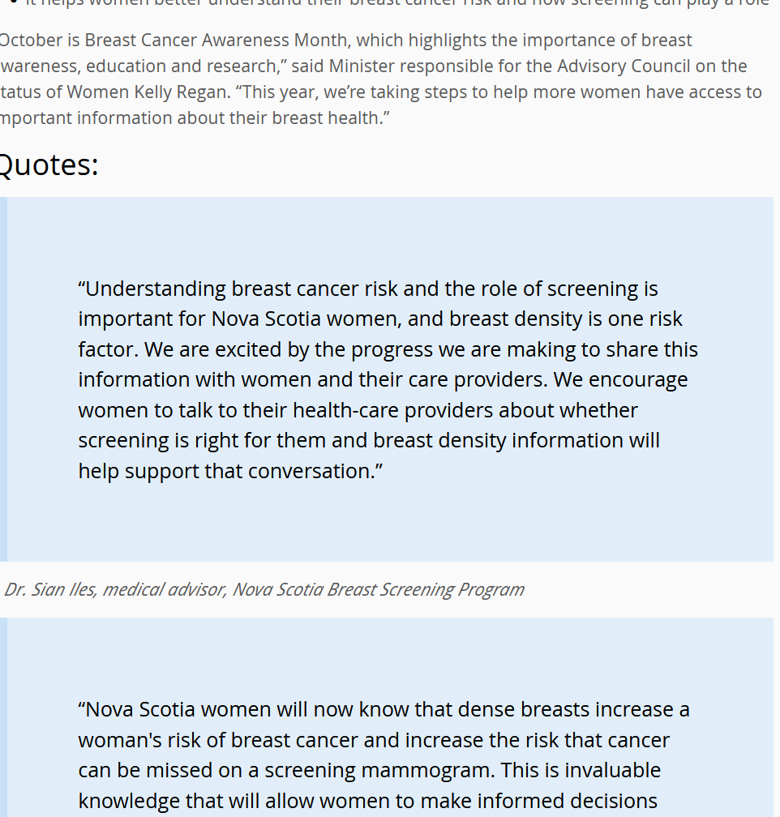
Breast density notification (Press release October 2019)
Notes:
Don’t try to read this one: Thanks to DBC’s advocacy, in 2019, Nova Scotia began to directly inform women of their breast density category, A, B, C, or D after their screening mammogram. So women can learn if they have dense breasts (category C or D), but in Nova Scotia they cannot access the additional and essential screening they need to help find breast cancer early.

Slide 5
Finding breast cancer at an early stage increases 5 year survival rates
Stage 1
100%
Stage 2
93%
Stage 3
72%
Stage 4
22%
Notes:
Early detection is critical with breast cancer. When diagnosed at stage 1, 100% of women survive 5 years. When a tumor is found by a symptom like a lump, it’s more likely to be later stage. Survival at 5 years for women diagnosed at stage 4 is only 22%.

Slide 6
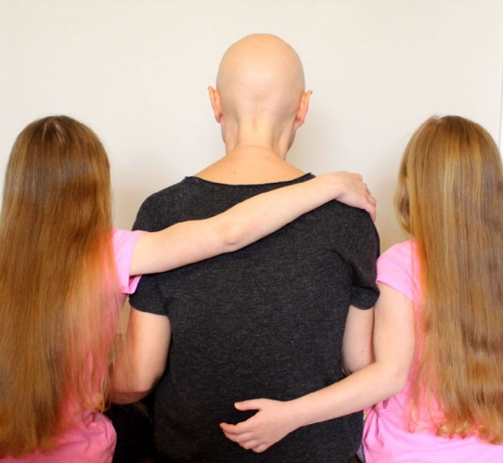
Additional benefits of early detection
Chance to avoid mastectomy.
Chance to avoid chemotherapy.
Chance for less armpit surgery.
Notes:
We want to find cancer early to save lives and also so that women can avoid harsh therapy like chemotherapy, mastectomies and lymphedema.

Slide 7
Women with dense breasts are underserved with just mammography
Mammograms are not perfect and do not find all cancers.
Having dense breasts is the most common reason for a cancer to be missed.
43% of women over age 40 have dense breasts.
Asian and Black women have higher rates of dense breasts.
Notes:
Mammograms don’t find all cancers. Having dense tissue is the most common reason for a cancer to be missed. Dense breasts are normal and common: 43% of women over age 40 have dense breasts. And dense breasts are more common in Asian and Black women.

Slide 8
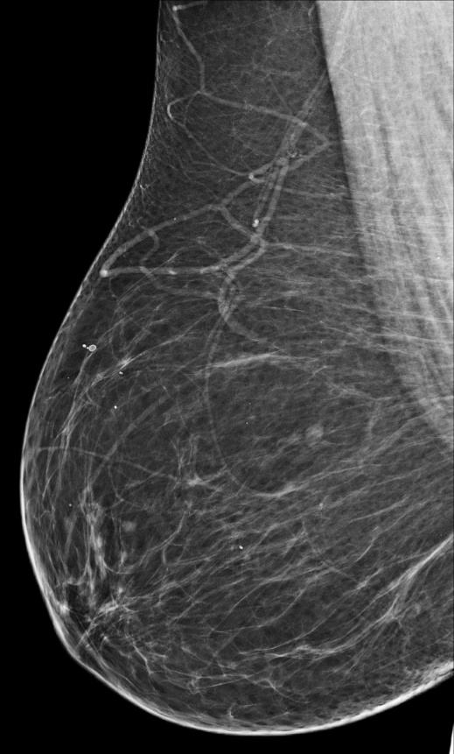
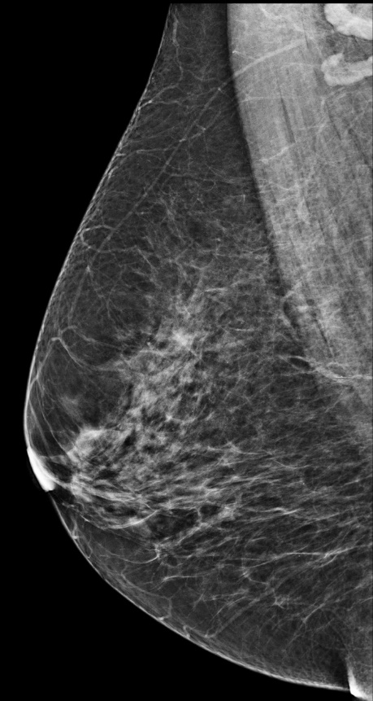
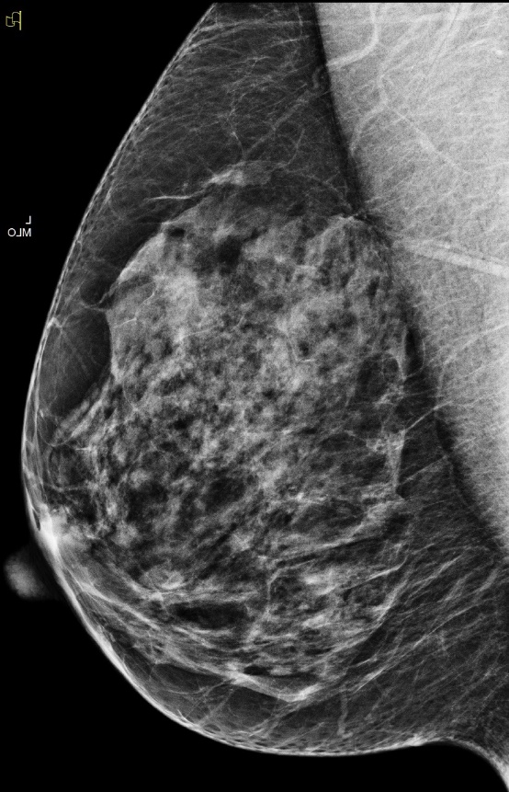
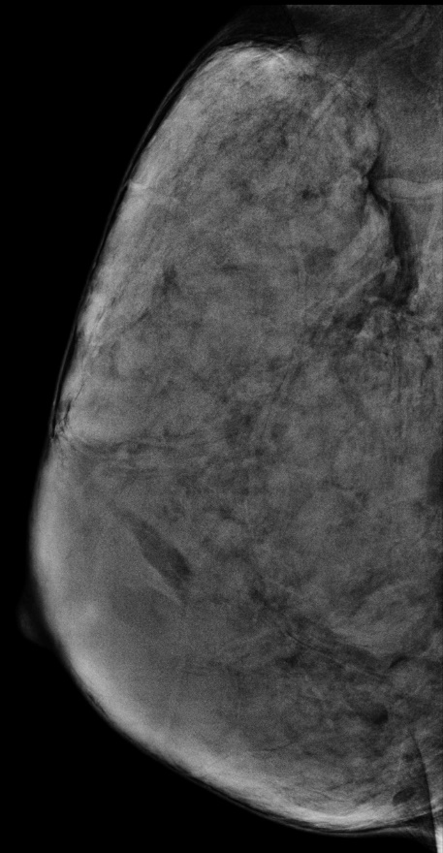
Four categories of breast density:
C and D are dense breasts
A
B
C
D
Fatty
Scattered Areas
Fibroglandular
Density
Heterogeneously
Dense
Extremely
Dense
Notes:
These breasts look quite different , but they’re all normal. The dark grey areas are fat, and the white areas are breast tissue. Dense breasts have more white tissue than fat. Radiologist divide brands density into four categories. Category A has almost all fat and no dense tissue, and category D is almost all breast tissue ans almost no fat.

Slide 9
Cancer is easily visible in a non dense breast (category A) but becomes more difficult to detect as breast density increases.
Notes:
Cancers are white, and this video shows how they are easily visible in non dense breasts but become more difficult to detect, especially in categories C and D breast tissue.
As many as 50% of cancers are missed in Category D breasts.

Slide 10
Dense breasts pose two risks:
Dense tissue increases the risk of getting breast cancer.
Women in category D have 4-6x higher risk of breast cancer than women in category A
Dense tissue increases the risk of breast cancer being missed.
Dense tissue and cancer both appear white on a mammogram, so cancers can be hidden
Higher risk of an interval cancer (cancer discovered between screenings)
Notes:
Not only is it harder for radiologists to find cancer but the double whammy is tat women with dense tissue are at increased risk of getting breast cancer.

Slide 11
Reducing interval cancers
can save lives
Cancer in women with dense breasts is often discovered when a woman feels a lump after a ‘normal’ mammogram.
These are called interval cancers. They are larger, more aggressive cancers, and later-stage.
Women are more likely to need chemo, mastectomy and are more likely to die.
Dense breasts increase the risk of interval cancers.
Many more cancers could be detected early, and lives saved if women with dense breasts were offered supplemental screening.
Notes:
Cancers that are not found and treated continue to grow until they’re large enough to be felt, and we call them “interval cancers,” because they’re found in the interval between planned mammograms. They are larger and more likely to have spread than cancers detected at screening. They tend to be more aggressive, and those women are more likely to need mastectomies and chemotherapy. AND they are more likely to die of their breast cancer. So women with dense breasts need more screening in addition to mammograms to reduce interval cancers. Women in Nova Scotia with dense breasts are discriminated against because they are denied the additional screening that can reduce interval cancers.

Slide 12
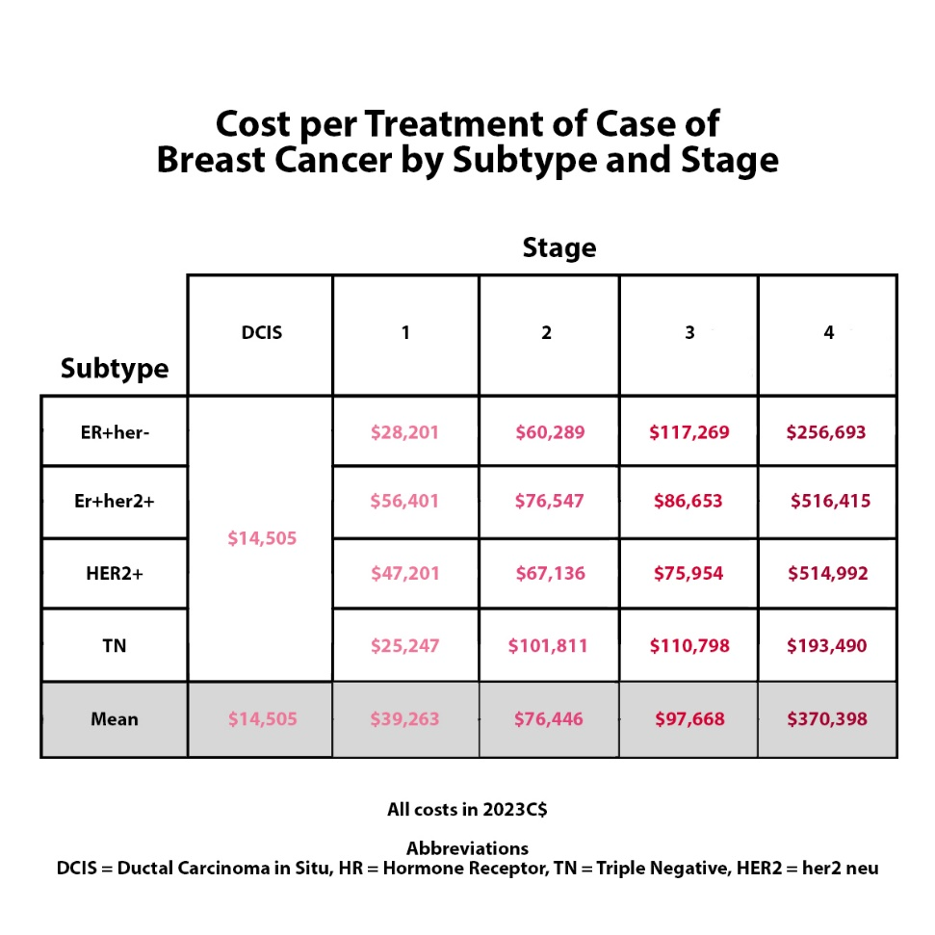
Costs of treating advanced
breast cancer in 2023
Women with dense breasts are at greater risk of a delayed and advanced diagnosis
Treatment for stage 1 cancer is $25,000-$56,000 per patient
Treatment for stage 4 cancer is $193,000-$516,000 per patient
~ 6% of women are considered stage 4 at time of diagnosis
Finding cancer early can save $
Wilkinson, Seely, Rushton et al Current Oncology, 2023
Notes:
There are many demands on the healthcare system. In addition to saving lives and improving quality of life, finding cancer early saves health care dollars.
With ever-increasing new treatments and higher survival rates, the costs of treating women with later stage breast cancer have risen significantly. Recently, Canadian researchers found that treating stage 4 breast cancer can cost over $500,000 per patient, depending on the subtype. Screening mammogram cost as little as $65. So it’s becoming more cost effective to do more screening to detect breast cancer early, than to treat advanced stage breast cancer.

Slide 13
Evidence shows additional cancers can be found using breast ultrasound
1995: ultrasound finds additional cancers missed on mammograms in dense breasts. Many studies have followed, all showing benefits of ultrasound.
J-START randomized controlled trial in Japan showing we can find many of those cancers when they are small and prevent them from becoming interval cancers with supplemental screening.
We can save lives.
Notes:
In October your screening program leadership told CBC that breast density is a relatively new consideration in a person's overall health. Actually, we’ve known about the risk of breast density for about 50 years, and we’ve known for almost 30 years from multiple studies that ultrasound finds additional breast cancers missed on mammograms in women with dense breasts. We can find many of those cancers when they are small and prevent them from becoming interval cancers with supplemental screening, usually with ultrasound, but sometimes MRI. A study in the Netherlands showed MRI can find up to 16 additional cancers in dense breasts missed on mammogram. Today I am focusing on ultrasound for women with dense breasts as it is more accessible and is used by other provinces. MRI is used in Nova Scotia for women with over 25% lifetime risk.

Slide 14
What are the barriers impacting
supplemental screening?
1. Shortage of trained ultrasound
technologists
Need more incentives to enroll in ultrasound training programs
Need competitive pay for techs, to retain them in the province
2. Concerns re false positives
3. GPs/NPs are being told there is no evidence showing the mortality benefit from supplemental screening
Notes:
What are the Barriers?
First: There’s a shortage of trained ultrasound technologists. We need to incentivize young people to enroll in ultrasound training programs, and the compensation for techs has to be competitive
Second: Another reason given to withhold ultrasound is false alarms- Like mammograms, Ultrasounds find abnormalities that ultimately prove to be benign. The need for further testing causes anxiety for women. However, short lived anxiety is not a reason to deny women ultrasound. It is paternalistic and patronizing to the women of Nova Scotia, who can make their own choices!
Third: In Nova Scotia one of the main barriers is The screening program telling GPs and the public that there is insufficient evidence to show ultrasound reduces deaths. The medical director for the Nova Scotia Breast Screening Program, said on the radio that there simply isn't enough evidence yet to support additional screening. Dr Iles was referring to research called RCTs that show reduced deaths.
As I mentioned there is decades of evidence showing that US can detect early cancers. No RCT has been completed yet on ultrasound, but there is one underway in Japan and it is showing a reduction in interval cancers which is a predictor of reduced deaths. By focusing only on mortality reduction, your screening program is ignoring all the other benefits of finding cancer early related to quality of life. If the screening program chooses to wait another decade for the RCT to be completed many lives may be lost in that time.

Slide 15
Province | Supplemental Screening Practices
Alberta British Columbia Ontario Quebec NWT | AB: Ultrasound for Category C and D with a requisition. Screening program recommendation 2022 for supplemental screening for Category D. BC: Health Minister made statement in 2018. Ultrasound available for Categories C & D with a requisition ON: Ontario Health Recommendation Dec 2023 for supplemental screening for Category D. Implementation date not given. In interim, requisition needed for Category C and D. QC: Ultrasound for Category C and D available with a requisition. Screening program recommendation for Cat D with family history NWT: Follow AB guidelines; can fly to AB for U/S
NB MB SK NL | No policies for or against; Access will vary
PEI | Commitment by Premier for Category D
YT | Not available
NS | Denied
Notes:
This jurisdictional scan shows that in a number of other jurisdictions screening ultrasound is accessible and paid for by provincial insurance. In BC, AB and ON, it is easily accessible
The clinic where I work performs about 4000 screening ultrasounds a year, finding additional cancers missed on mammography. Official recommendations have recently been announced in AB and Ontario for supplemental screening for women with category D. This is great, but women in both C and D need additional screening.

Slide 16
Takeaways
One size does not fit all.
Women with dense breasts are at greater risk of a delayed and advanced diagnosis, including larger tumours and cancer that has spread.
All women deserve the opportunity for early diagnosis, and women with dense breasts are discriminated against if they are only offered mammograms; they need additional screening.
Treatment for stage 4 cancer is $193,000-$516,000 per patient
Currently, Nova Scotia is the only province where supplemental screening is denied, even with a requisition.
Notes:
One size does not fit all
Women with dense breasts are at greater risk of a delayed and advanced diagnosis, including larger tumours and cancer cells that are more likely to have left the breast to metastasize.
Women with dense breasts are discriminated against if they are only offered mammograms; they need additional screening.
Treatment for stage 4 cancer is $193,000-$516,000 per patient
Currently, Nova Scotia is the only province where supplemental screening is denied, even with a requisition
Currently, Nova Scotia is the only province where supplemental screening is denied, even with a requisition

Slide 17
Recommendation
To improve early detection of breast cancer, reduce deaths, reduce suffering for women and those who care about them and save $ on treatment costs
Provide supplemental screening to women with Category C and D dense breasts so that they have a chance to find breast cancer early.
Lives depend on it.
Notes:
To improve early detection of breast cancer, reduce deaths, reduce suffering related to breast cancer for women and those who care about them and save $ on treatment costs, supplemental screening should be provided to women with category C and D dense breasts so that they have a chance to find breast cancer early.
Lives depend on it.

Slide 18
Story from Patient Advocate: Elizabeth Shein
Notes:
I'm happy to take questions but first I’d like to introduce you to patient advocate Elizabeth Shien. She has been advocating to ensure women in NS do not have to go through what she went though, Thank you Elizabeth

